Slide 1
Stanford NLP tools
Wenjing Fang(Bean)
littlebeanfang@sjtu.edu.cn

Slide 2
Preface
Purpose:
General intro v.s. Mechanism
Resources:
http://nlp.stanford.edu/software/index.shtml
http://cogcomp.cs.illinois.edu/page/software
http://opennlp.sourceforge.net/projects.html
1
Notes:
Say no to mechanism-related question
Lab direction, get a quick start on ur work.
Take stanford tools as a example, intro most common tools.
Easy to follow, and may be a very short talk
Open the stanford webpage in advance.

Slide 3
Content
POS tagger
NER & SUTime
Parser
Chunker
Tregex & Tsurgeon
MaltEval
Segmenter & annotator

Slide 4
Content
POS tagger
NER & SUTime
Parser
Chunker
Tregex & Tsurgeon
MaltEval
Segmenter & annotator

Slide 5
POS tagger
In General
  POS(Part of speech ): Grammatical class of word
  Penn POS tag set
  https://www.ling.upenn.edu/courses/Fall_2003/ling001/penn_treebank_pos.html
  E.g. duck (noun in single form -> NN)
  saw (verb in past tense -> VBG)
  Assign parts of speech to each word
  State of art : Log-linear , accuracy 97.24%
Notes:
Maximum Entropy model + rich feature: Log-linear, 97.24%(Quite high)

Slide 6
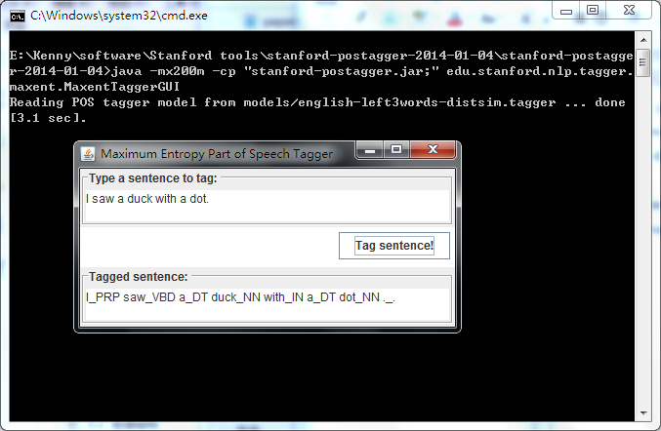
POS tagger
In General
Usage and example

Slide 7
POS tagger
In General
Usage and example
Application
  A intermediate process: Assist parser
  Help with information extraction
Notes:
Since we have rules for our language
And POS is the most important syntactic information
Or it can help with some pattern work of information extraction

Slide 8
Content
POS tagger
NER & SUTime
Parser
Chunker
Tregex & Tsurgeon
MaltEval
Segmenter & annotator

Slide 9
NER
In general
  NER(name entity recognition)
  labels sequences of words -> names of things
  E. g. Person, company names or time etc.
  Feature: Word combination
  character prefix etc.
Notes:
Conditional Random Field sequence model, together with well-engineered features
no POS tag

Slide 10
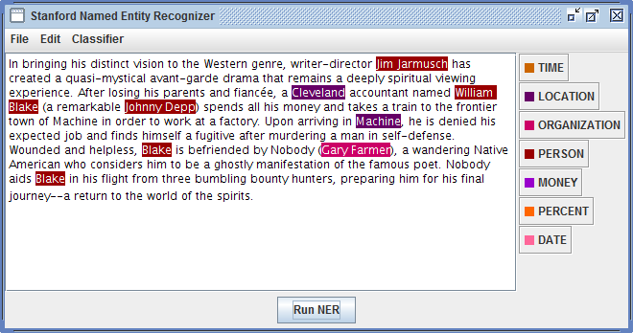
NER
In general
Usage and example(7 classes)

Slide 11
NER
In general
Usage and example(7 classes)
  NER system for Jane Austen novels

Slide 12
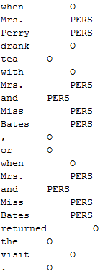
NER
In general
Usage and example(7 classes)
  NER system for Jane Austen novels
  Training data and configuration

Slide 13
NER
In general
Usage and example
Application
  QA
  Textual Entailment
Notes:
It’s often necessary for us to recognize the special entities in practical projects, especially some QA and textual entailment tasks

Slide 14
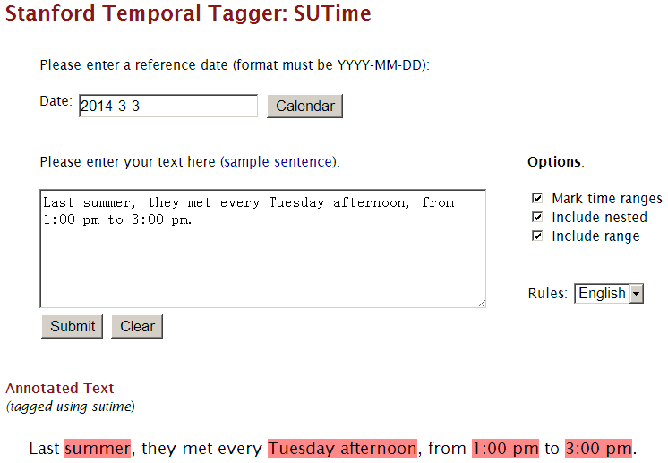
SUTime
Notes:
Especially for time

Slide 15
Content
POS tagger
NER & SUTime
Parser
Chunker
Tregex & Tsurgeon
MaltEval
Segmenter & annotator

Slide 16
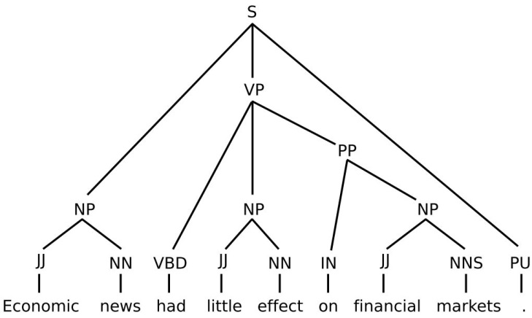
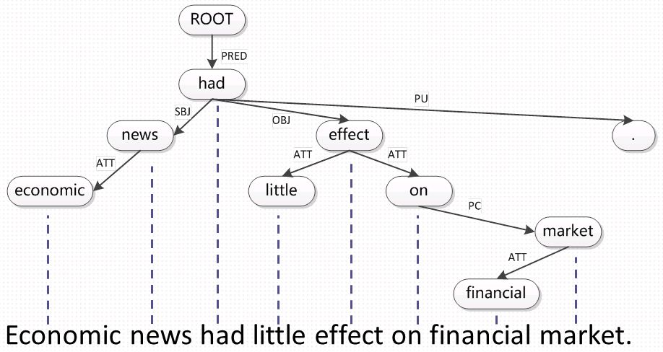
Parser
In general
  Grammatical structure of sentences
  2 forms: phrase structure and dependency
  Preprocess: POS tag

Slide 17
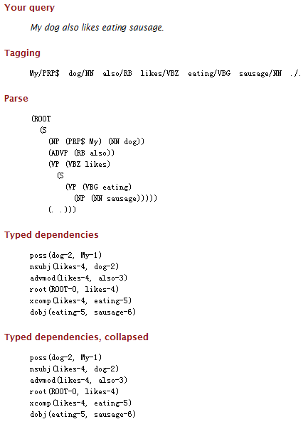
Parser
In general
Usage and example

Slide 18
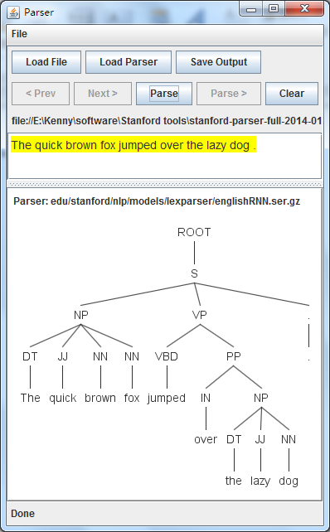
Parser
In general
Usage and example

Slide 19
Parser
In general
Usage and example
Application
Improvement:
  Representations
  Parsing model
  Parsing algorithm
Notes:
Last seminar, 3 parsers representation, model and algorithm quick review

Slide 20
Content
POS tagger
NER & SUTime
Parser
Chunker
Tregex & Tsurgeon
MaltEval
Segmenter & annotator

Slide 21
Chunker
http://cogcomp.cs.illinois.edu/demo/shallowparse/?id=7
Also called shallow parsing
In general
  Identifies the constituents(linear)
    noun groups, verbs, verb groups, etc.
    E.g.
  Not specify
    Internal structure
    Role in the main sentence
Notes:
Sometimes , it’s not necessary for us to parse exactly to every word, we may concentrate on the union of span of words and have no interest in the relation inner a span.

Slide 22
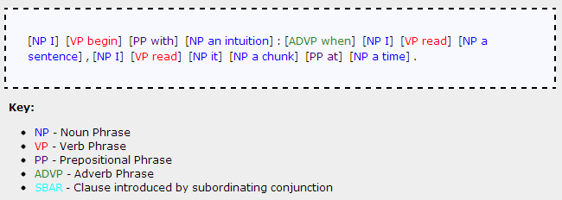
Chunker
Also called shallow parsing
In general
Usage and example
I begin with an intuition: when I read a sentence, I read it a chunk at a time.
Notes:
Sometimes , it’s not necessary for us to parse exactly to every word, we may concentrate on the union of span of words and have no interest in the relation inner a span.

Slide 23
Content
POS tagger
NER & SUTime
Parser
Chunker
Tregex & Tsurgeon
MaltEval
Segmenter & annotator

Slide 24
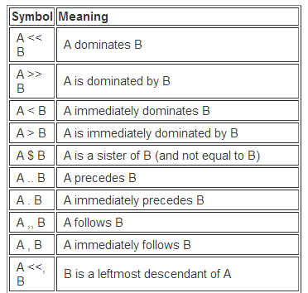
Tregex & Tsurgeon
In general
  Graphical interface
  Special tree finder
    tree relationships
    regular expression matches
  Tree transformation(surgeon)

Slide 25
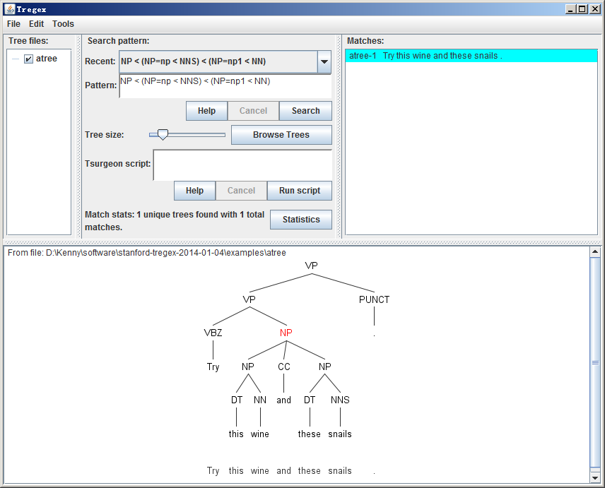
Tregex & Tsurgeon
In general
Usage

Slide 26
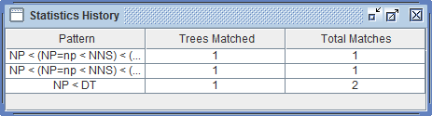
Tregex & Tsurgeon
In general
Usage
Tricks
  Tree graph
  Filter trees(pattern) and get statistics
  Turn into sentences
  Do surgery on trees: prune or change

Slide 27
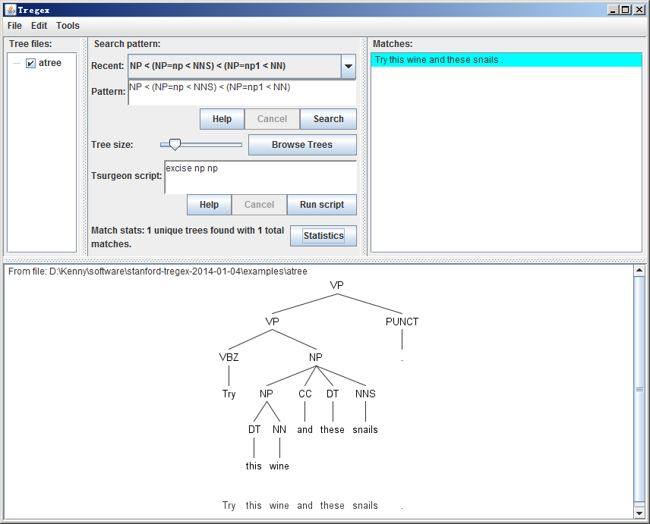
Tregex & Tsurgeon
In general
Usage
Tricks
  Tree graph
  Filter trees(pattern) and get statistics
  Turn into sentences
  Do surgery on trees: prune or change

Slide 28
Content
POS tagger
NER & SUTime
Parser
Chunker
Tregex & Tsurgeon
MaltEval
Segmenter & annotator

Slide 29
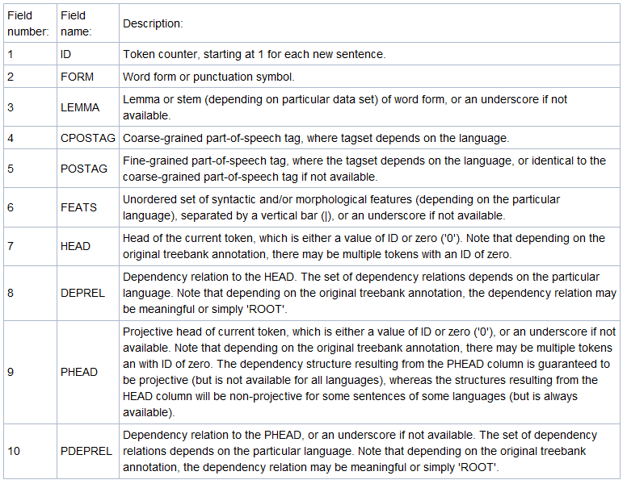
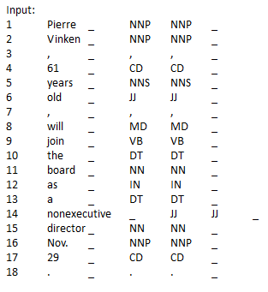
MaltEval
In general http://www.maltparser.org/malteval.html
  Visualize the dependency tree(CONLL format)
  Evaluate the performance of parser(v.s. gold parse)

Slide 30
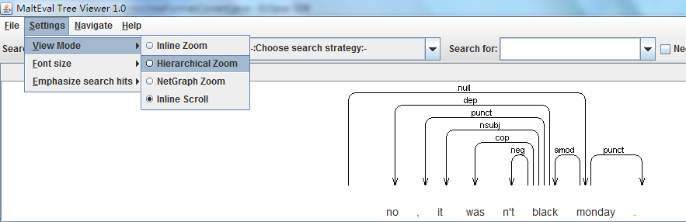
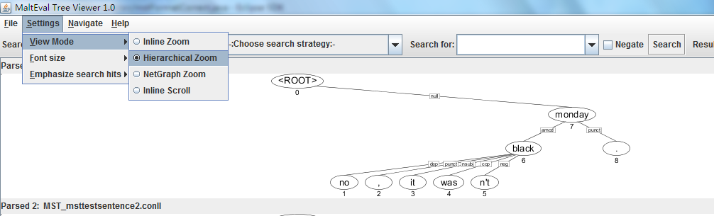
MaltEval
In general
Usage

Slide 31
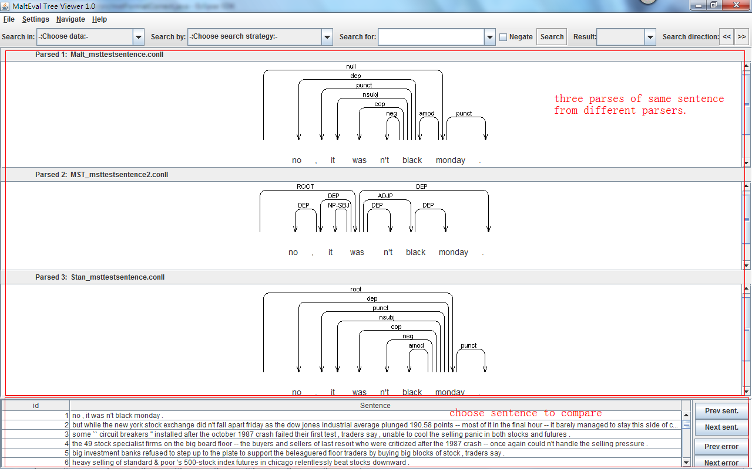
MaltEval
In general
Usage

Slide 32
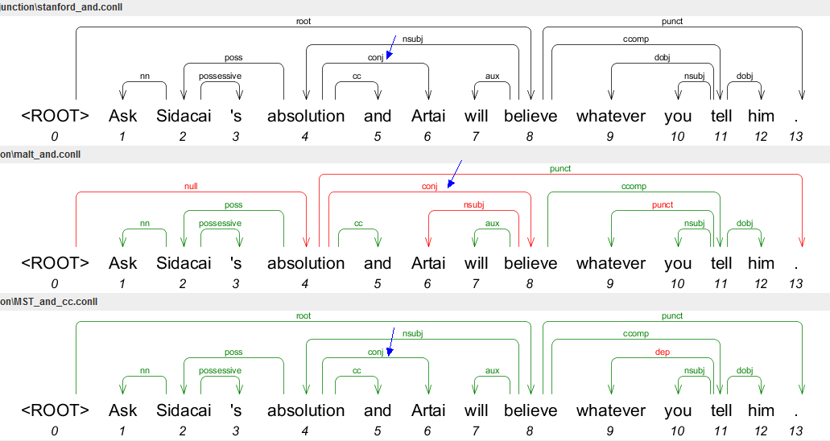
MaltEval
In general
Usage

Slide 33
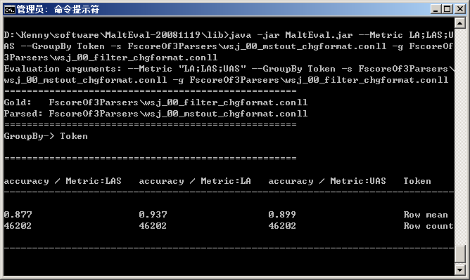
MaltEval
In general
Usage

Slide 34
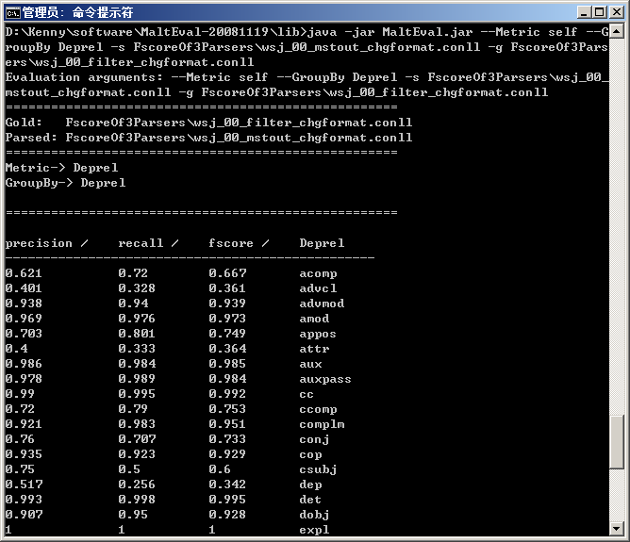
MaltEval
In general
Usage

Slide 35
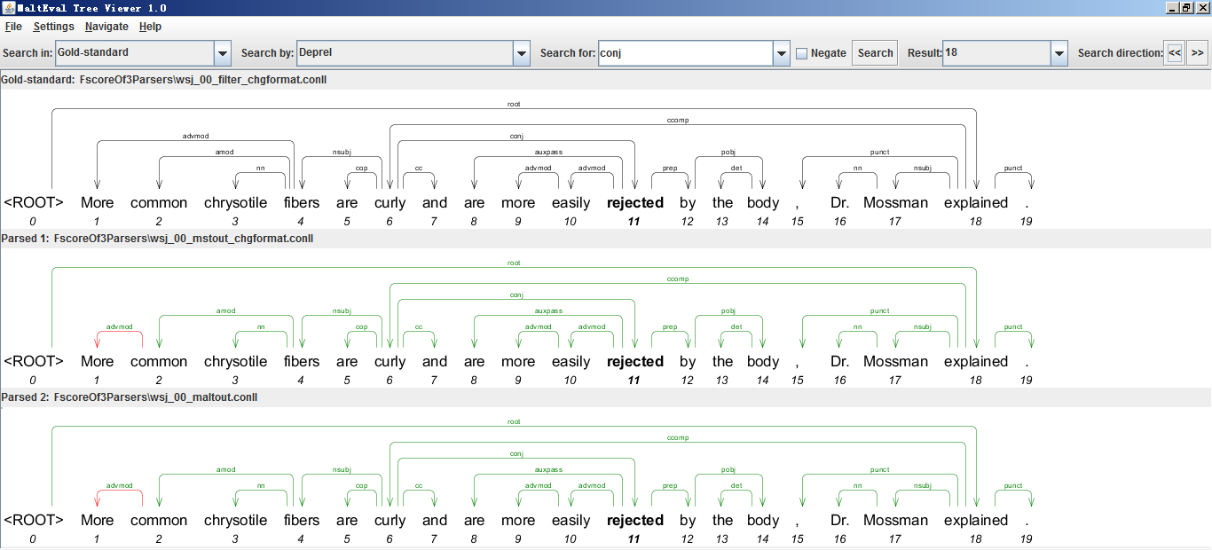
MaltEval
In general
Usage
Notes:
highlighted in bold

Slide 36
Content
POS tagger
NER & SUTime
Parser
Chunker
Tregex & Tsurgeon
MaltEval
Segmenter & annotator

Slide 37
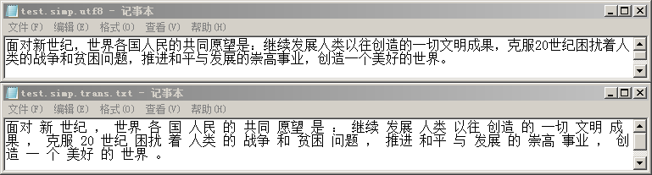
Segmenter
Tokenization: For Chinese and Arabic etc.
Chinese is standardly written without spaces
Split text into a sequence of words

Slide 38
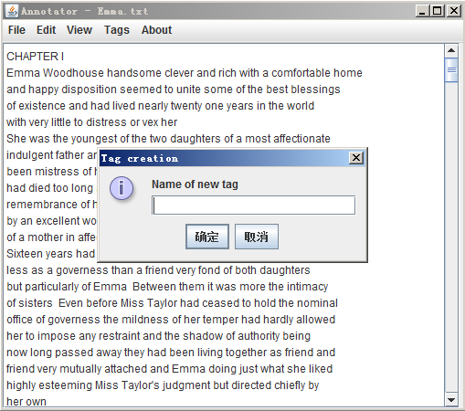
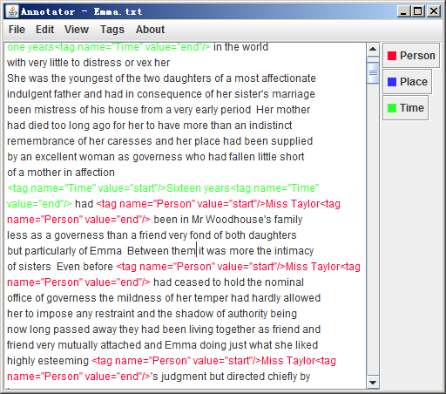
Annotator
Simple

Slide 39
Thank you!
Contact: littlebeanfang@sjtu.edu.cn

